Slide 1





Fraud Management
Platform for SAP®
Udi Jacoby
Email: udi.j@Skywind.com

Slide 2





info@skywind.com
| www.skywind.com
About Skywind & 4C™
Founded in 2011
Skywind Cloud Platform helps
our customers to:
Gain visibility over their Fraud Management strategy
Validate and detect business processes ineﬃciencies
Control BW operations and optimize towards HANA
migration
Optimize SAP® Background Jobs and save ~20% of
time
Monitor Basis related processes
(Interfaces/Communications/DB/Printing etc.)
Serves SAP® customers across many industries
Retail, Finance, Healthcare, Education, Oil & Gas, Manufacturing, Logistics, Food & Beverages, Government

Slide 3
















info@skywind.com
| www.skywind.com
4c™ Selected Customers

Slide 4




info@skywind.com
| www.skywind.com
SAP® Monitoring Reality
The Challenge:
Use Solman or other solutions
to monitor Basis and infra’
Near zero visibility of Fraudulent
activities, Business errors,
BW issues and background jobs challenges
Use performance monitoring
to ensure availability
Complexity (time consuming and expensive)
Creating effective alerts that combine real time analytics and business processes validation requires long and deep analysis of SAP® systems

Slide 5
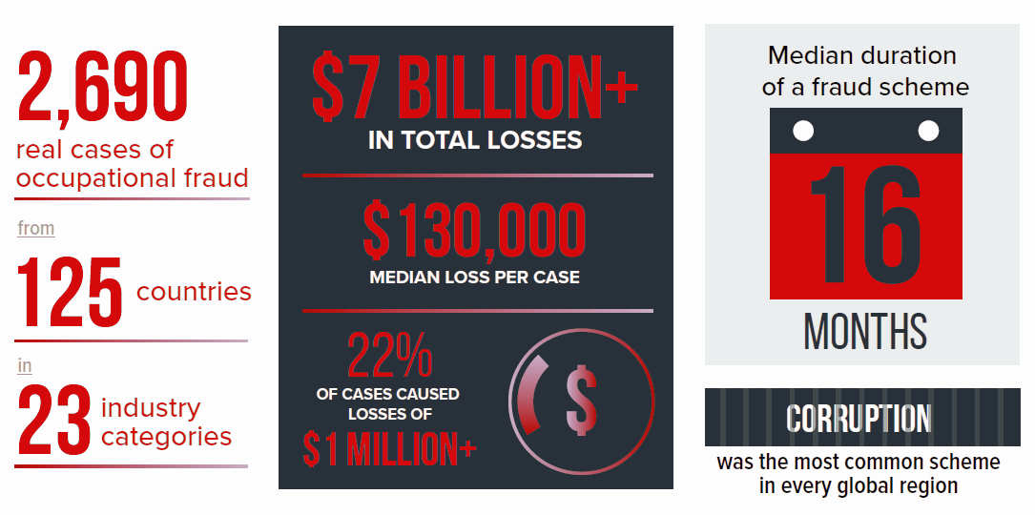
info@skywind.com
| www.skywind.com
Increased Impact and Risk Of Fraud
Fraud is epidemic!

Slide 6




info@skywind.com
| www.skywind.com
Increased Impact and Risk Of Fraud
Fraud is epidemic!
?
36%
23%
15%
+8%
+13%
+?%
2014
2016
2018
2020
* Created by ABeam based on "Economic Crime Survey 2018" https://www.pwc.com/jp/ja/knowledge/thoughtleadership/economic-crime-survey.html

Slide 7


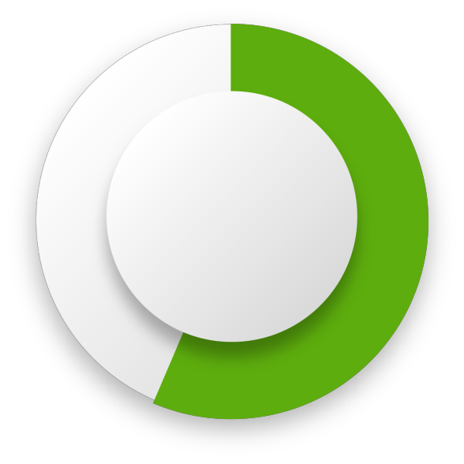


info@skywind.com
| www.skywind.com
Increased Impact and Risk Of Fraud
Reduction Eﬀect by Fraud Data Monitoring
52%
58%
Reduction of Fraudulent Amount
Reduction of Fraudulent Duration
*Created by Abeam Consulting and Skywind based on “2018 Report to the Nations. Copyright 2018 by the Association of Certiﬁed Fraud Examiners, Inc.”
http://www.acfe.com/report-to-the-nations/2018/

Slide 8





info@skywind.com
| www.skywind.com
Fund Transfer Fraud Detection
BACKGROUND
CHALLENGE
SOLUTION
BUSINESS
OUTCOMES
The bank uses over 150 alerts to monitor their business health.
How to validate that the eﬀorts we made are good enough?
4C™ monitored if changes made to vendors bank account details – either by unauthorized user or temporary changes made by authorized users
Eliminating the Risk - Skywind identified that each quarter for 4 days a bank account of a certain vendor is changed into an unknown bank account. The acting parties were traced and confessed.
The bank added many additional alerts to cover additional scenarios and protect their business.
They invested signiﬁcant eﬀort to categorize various ﬁelds to perform unauthorized changes
Their SAP® system has strong vendor maintenance screen authorization features without proper approvals

Slide 9



info@skywind.com
| www.skywind.com
Skywind 4C™ - Fraud Management Platform for SAP®
Real time monitoring solution to detect and notify the right person
Over 250
out of the box alerts
Finds the unknown to reduce risks
Saves time and money
Validating your Fraud Management strategy
PROCUREMENT MANAGEMENT
STOCK MANAGEMENT
SALES & LOGISTICS
FINANCIAL ACCOUNTING
and more...
Self Approved POs/PRs
Updates on Vendor bank accounts
Changing purchasing
Price
Pos with onetime vendor
High amount inventory variance
Suspicious Material movements
Inappropriate Material conversions
Duplicated discounts in Sales Orders
Excessive credit memo for a Payer
Update on payment Terms
Inactive vendor with an open balance
Exceptional postings by
GL accounts
Suspicious Expenses
Vendor related documents without Pos

Slide 10

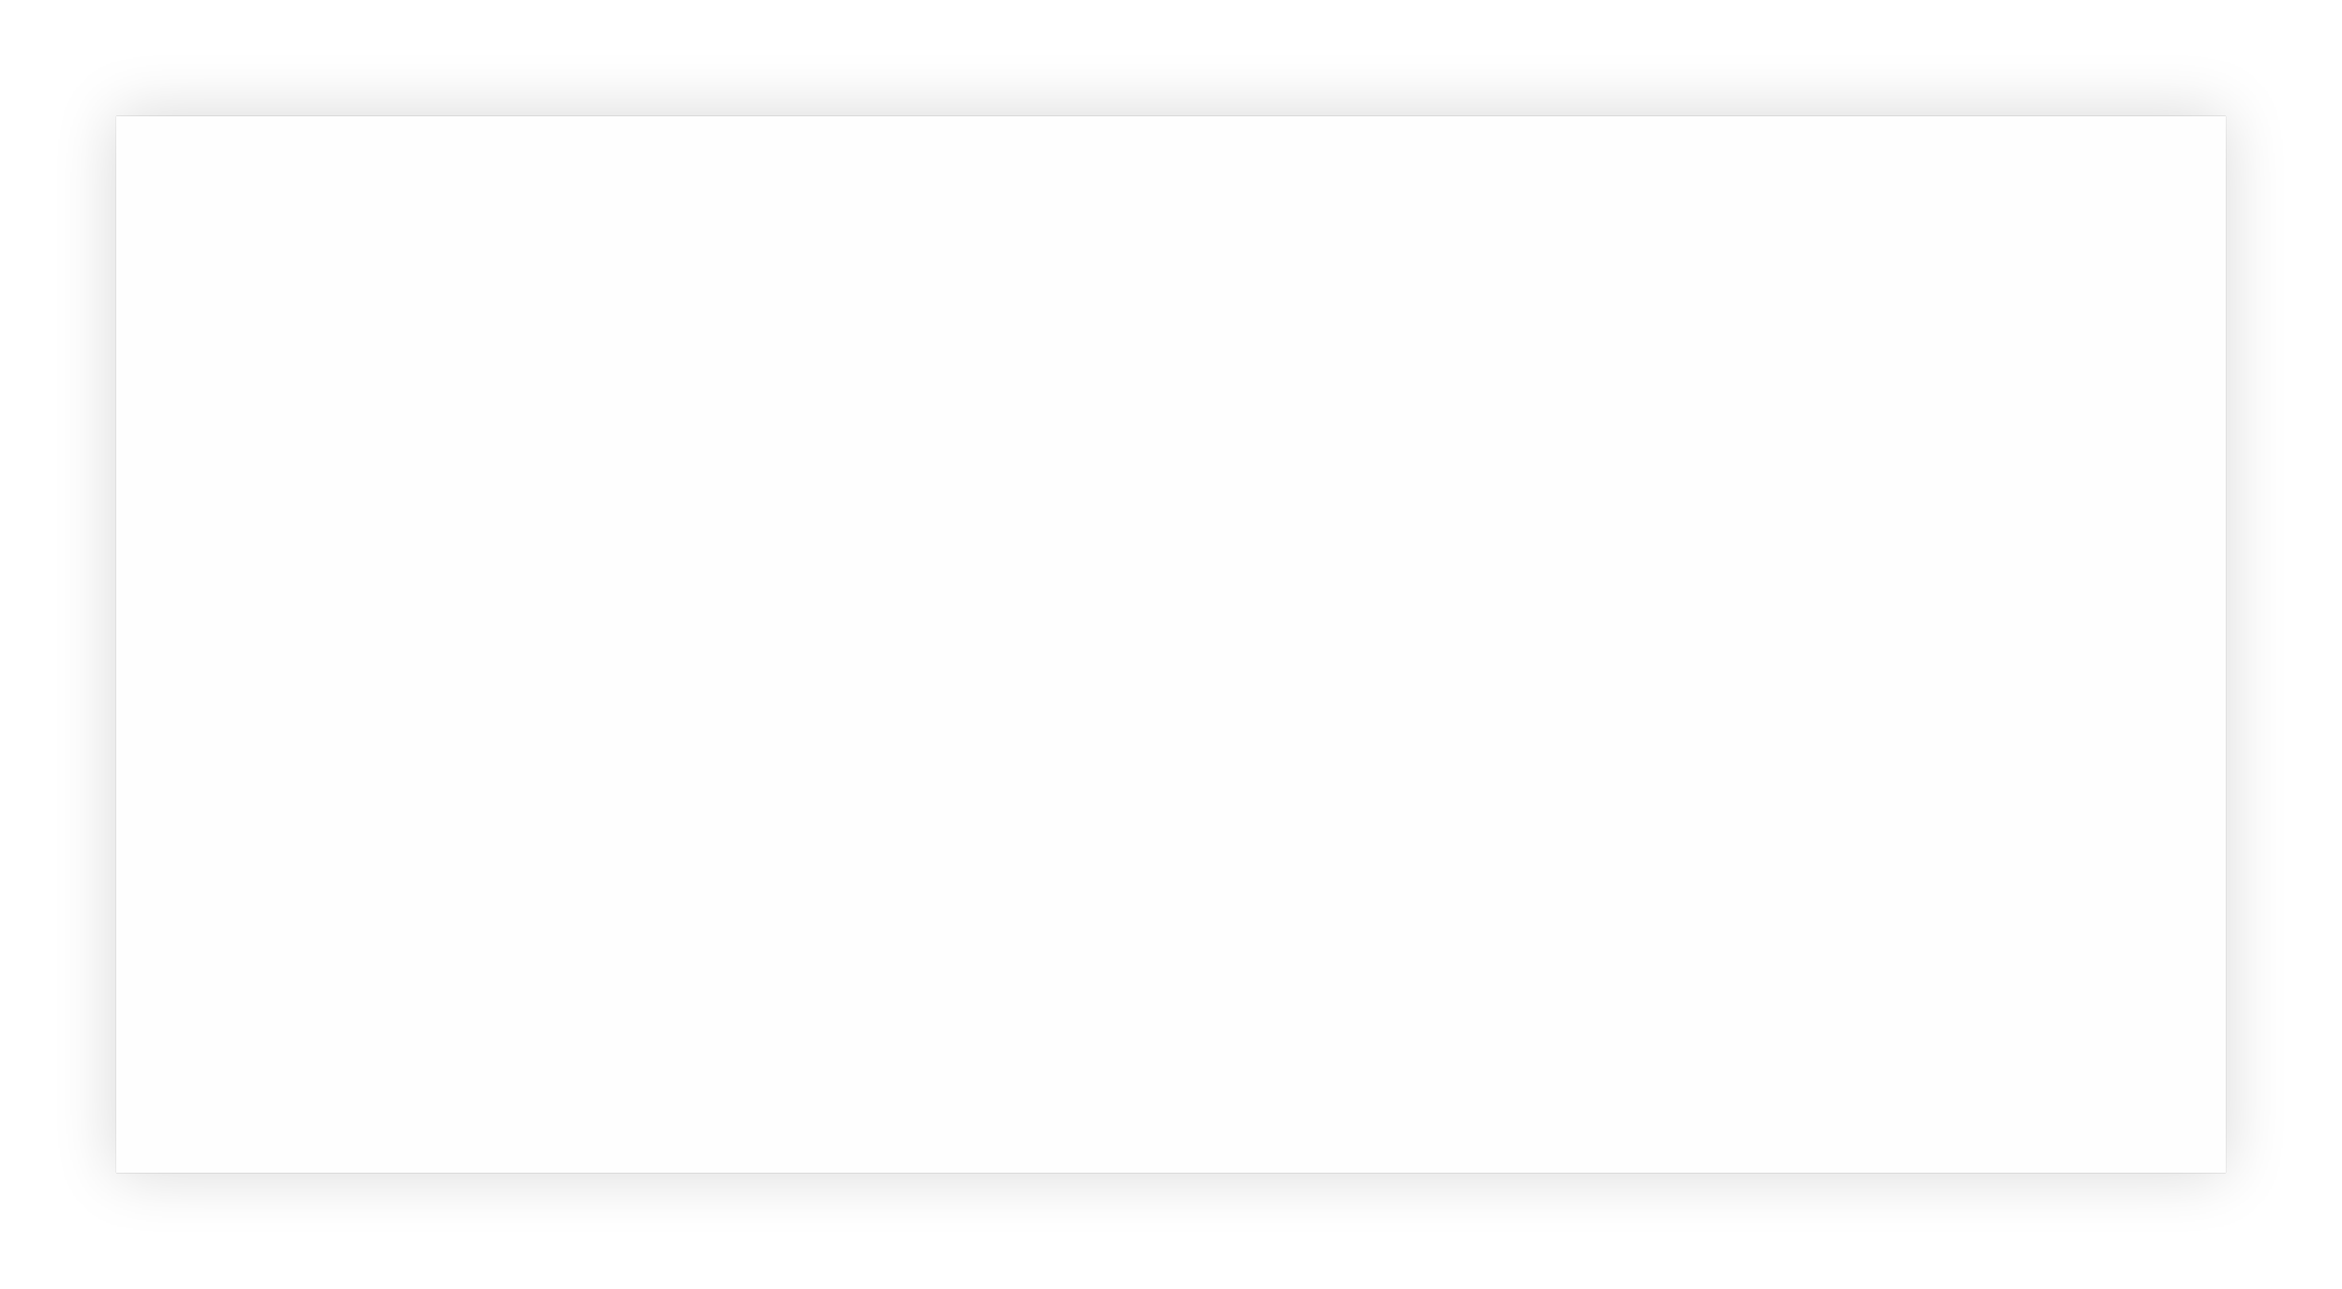
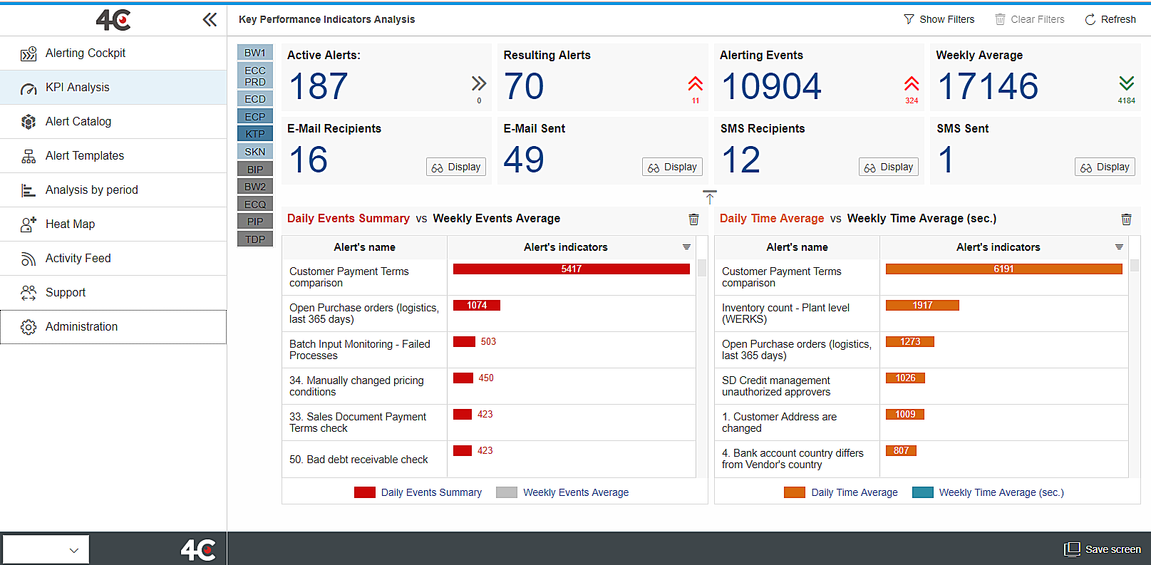
info@skywind.com
| www.skywind.com
Demo

Slide 11


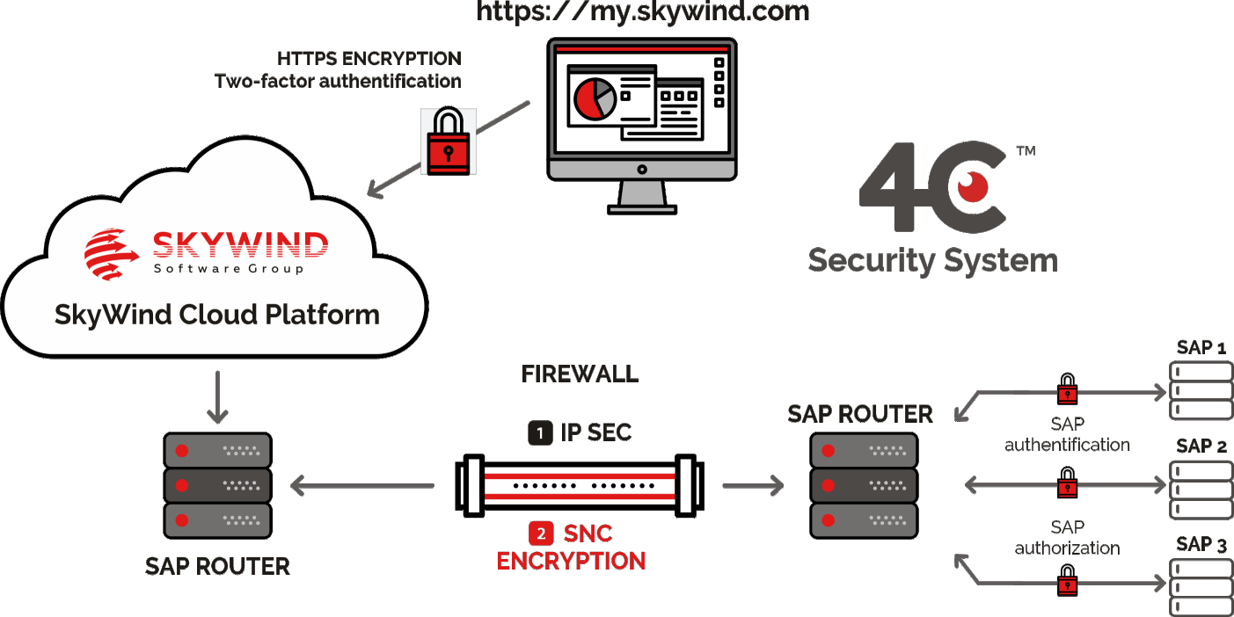
info@skywind.com
| www.skywind.com
Skywind 4C™ – Seamless Setup
NO
SOFTWARE
NO
HARDWARE
NO
INSTALLATION
NO
IMPLEMENTATION

Slide 12

Get Your Fraud Management Trial Today!
Collect & Analyse
& Fine-tuning & Next Steps
Scope
Alert Setup
Current &
Historical Data
Conclusions
Seamless & secure setup
COST:
30 DAYS - $15K
60 DAYS - $20K
$25K
$40K
Choose up to 15 alerts for 30 or 60 days service
Full report on current status of fraud and
up to 1 year history analysis
Oﬀer is valid for SAPPHIRE delegates until May 31st, 2019

Slide 13

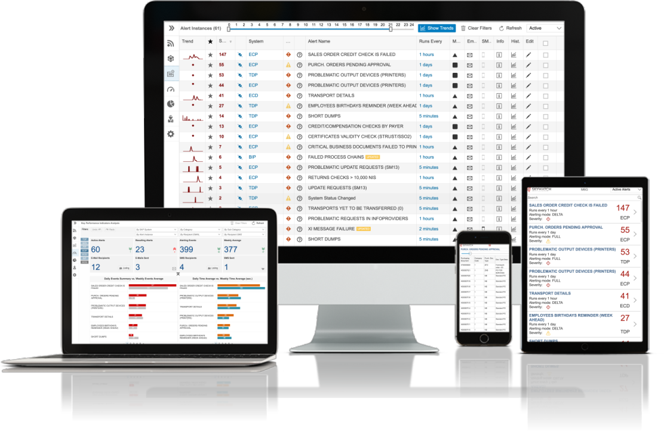



Thank you!
Smooth
SAP Operation
info@skywind.com | www.skywind.com

